Slide 1
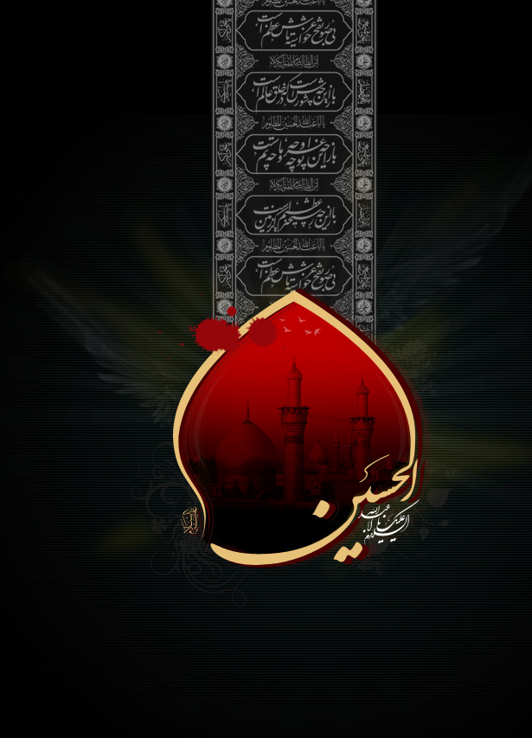
بسم الله الرحمن الرحيم اللهم عجل لوليك الفرج
سورة الفجر
اللهُمَّ وَلا تَسْلُبْنَا اليَقِينَ لِطُولِ الأمَدِ فِي غَيْبَتِهِ وَانْقِطاعِ خَبَرِهِ عَنّا وَلا تُنْسِنا ذِكْرَهُ وَانْتِظارَهُ وَالإيمانَ بِهِ وَقُوَّةَ اليَقِينَ فِي ظُهُورِهِ وَالدُّعاءَ لَهُ وَالصَّلاةَ عَلَيْهِ
“O Allah, do not deprive us of certainty due to the prolongation of his occultation and cessation of news of him from us, and do not let us forget his remembrance and his awaiting, and with it increase our belief in him, the strength of certainty in his reappearance, praying for him and invoking blessings on him”
إِنَّهُمْ يَرَوْنَهُ بَعِيداً وَنَرَاهُ قَرِيباً
“Surely, they see it to be far off, and We see it near”

Slide 2
بِسْمِ اللّٰهِ الرَّحْمٰنِ الرَّحِيمِ
In the Name of Alláh,
the All-beneficent, the All-merciful.

Slide 3
وَالْفَجْرِ ‎﴿١﴾‏ وَلَيَالٍ عَشْرٍ ‎﴿٢﴾
By the Dawn,
by the ten nights,

Slide 4
وَالشَّفْعِ وَالْوَتْرِ ‎﴿٣﴾ وَاللَّيْلِ إِذَا يَسْرِ ‎﴿٤﴾‏
by the Even and the Odd,
by the night when it departs!

Slide 5
هَلْ فِي ذٰلِكَ قَسَمٌ لِّذِي حِجْرٍ ‎﴿٥﴾
Is there an oath in that for one possessing intellect?

Slide 6
أَلَمْ تَرَ كَيْفَ فَعَلَ رَبُّكَ بِعَادٍ ‎﴿٦﴾
Have you not regarded how your Lord dealt with [the people of] ‘Ad,

Slide 7
إِرَمَ ذَاتِ الْعِمَادِ ‎﴿٧﴾‏
[and] Iram, [the city] of the pillars,

Slide 8
الَّتِي لَمْ يُخْلَقْ مِثْلُهَا فِي الْبِلَادِ ‎﴿٨﴾
the like of which was not created among cities,

Slide 9
وَثَمُودَ الَّذِينَ جَابُوا الصَّخْرَ بِالْوَادِ ‎﴿٩﴾
and [the people of] Thamud, who hollowed out the rocks in the valley,

Slide 10
وَفِرْعَوْنَ ذِي الْأَوْتَادِ ‎﴿١٠﴾
and Pharaoh, the impaler

Slide 11
الَّذِينَ طَغَوْا فِي الْبِلَادِ ‎﴿١١﴾
—those who rebelled [against Allah] in their cities

Slide 12
فَأَكْثَرُوا فِيهَا الْفَسَادَ ‎﴿١٢﴾
and caused much corruption in them,

Slide 13
فَصَبَّ عَلَيْهِمْ رَبُّكَ سَوْطَ عَذَابٍ ‎﴿١٣﴾
so your Lord poured on them lashes of punishment.

Slide 14
إِنَّ رَبَّكَ لَبِالْمِرْصَادِ ‎﴿١٤﴾
Indeed your Lord is in ambush.

Slide 15
فَأَمَّا الْإِنسَانُ إِذَا مَا ابْتَلَاهُ رَبُّهُ فَأَكْرَمَهُ وَنَعَّمَهُ فَيَقُولُ رَبِّي أَكْرَمَنِ ‎﴿١٥﴾
As for man, whenever his Lord tests him, and grants him honour, and blesses him, he says, ‘My Lord has honoured me.’

Slide 16
وَأَمَّا إِذَا مَا ابْتَلَاهُ فَقَدَرَ عَلَيْهِ رِزْقَهُ فَيَقُولُ رَبِّي أَهَانَنِ ‎﴿١٦﴾‏
But when He tests him and tightens for him his provision, he says, ‘My Lord has humiliated me.’

Slide 17
كَلَّا ۖ بَل لَّا تُكْرِمُونَ الْيَتِيمَ ‎﴿١٧﴾
No indeed! No, you do not honour the orphan,

Slide 18
وَلَا تَحَاضُّونَ عَلٰى طَعَامِ الْمِسْكِينِ ‎﴿١٨﴾‏
and do not urge the feeding of the needy.

Slide 19
وَتَأْكُلُونَ التُّرَاثَ أَكْلًا لَّمًّا ‎﴿١٩﴾
You eat the inheritance rapaciously,

Slide 20
وَتُحِبُّونَ الْمَالَ حُبًّا جَمًّا ‎﴿٢٠﴾‏
and love wealth with much fondness.

Slide 21
كَلَّا إِذَا دُكَّتِ الْأَرْضُ دَكًّا دَكًّا ‎﴿٢١﴾
No indeed! When the earth is levelled to a plain,

Slide 22
وَجَاءَ رَبُّكَ وَالْمَلَكُ صَفًّا صَفًّا ‎﴿٢٢﴾
and your Lord [’s edict] arrives with the angels in ranks,

Slide 23
وَجِيءَ يَوْمَئِذٍ بِجَهَنَّمَ ۚ يَوْمَئِذٍ يَتَذَكَّرُ الْإِنسَانُ وَأَنّٰى لَهُ الذِّكْرٰى ‎﴿٢٣﴾
the day when hell is brought [near], man will take admonition on that day, but what will that admonition avail him?

Slide 24
يَقُولُ يَا لَيْتَنِي قَدَّمْتُ لِحَيَاتِي ‎﴿٢٤﴾
He will say, ‘Alas, had I sent ahead for my life [in the Hereafter]!’

Slide 25
فَيَوْمَئِذٍ لَّا يُعَذِّبُ عَذَابَهُ أَحَدٌ ‎﴿٢٥﴾
On that day none shall punish as He punishes,

Slide 26
وَلَا يُوثِقُ وَثَاقَهُ أَحَدٌ ‎﴿٢٦﴾
and none shall bind as He binds.

Slide 27
يَا أَيَّـتُهَا النَّفْسُ الْمُطْمَئِنَّةُ ‎﴿٢٧﴾‏
‘O soul at peace!

Slide 28
ارْجِعِي إِلٰى رَبِّكِ رَاضِيَةً مَّرْضِيَّةً ‎﴿٢٨﴾
Return to your Lord, pleased and pleasing!

Slide 29
فَادْخُلِي فِي عِبَادِي ‎﴿٢٩﴾ وَادْخُلِي جَنَّتِي ‎﴿٣٠﴾‏
Then enter among My servants, and enter My paradise!’

Slide 30
أَللّٰهُمَّ صَلِّ عَلٰى مُحَمَّدٍ وَآلِ مُحَمَّدٍ
O' Alláh send Your blessings on Muhammad
and the family of Muhammad.

Slide 31

Please recite a Surah al-Fatiha for all marhumeen
Kindly recite Surah Al-Fātiḥa for Marhumeen of all those who have worked towards making this small work possible.
Courtesy of

